Slide 1
URC and Quaker reflective resource
Notes:
This is a resource to use with a group of adults to encourage them to reflect on their relationships with young people in any area of their life (church/meeting, family, work, neighbourhood, social activities etc). we hope it will remind them that they do have connection with young people in their lives.
The aim is to encourage them to see themselves as having something to offer young people as a person of faith and to nurture these relationships.
This is a reflective craft activity – it requires no particular crafting skills – using a slice of wood, pens, some stickers and string to create a decorative item to hang up as a reminder of their role in the life of a young person.

Slide 2
How can we make the meeting a community in which each person is accepted and nurtured, and strangers are welcome?

Slide 3
Seek to know one another in the things which are eternal, bear the burden of each other’s failings and pray for one another.
As we enter with tender sympathy into the joys and sorrows of each other’s lives, ready to give help and to receive it, our meeting can be a channel for God’s love and forgiveness.
Quaker Advices and queries 18
Notes:
Invite everyone to talk about this quote (if helpful substitute ‘meeting’ with ‘church’):
Do they agree with it as an aim?
How might this be particularly extended to include young people?

Slide 4
Think of a young person you know or have known
family member
neighbour or friend
through work
through a shared social activity
through church/meeting
Notes:
Encourage everyone to think of a particular young person – if possible one they know now, otherwise one they have known.
Invite them to share a little about this young person with their neighbour.

Slide 5
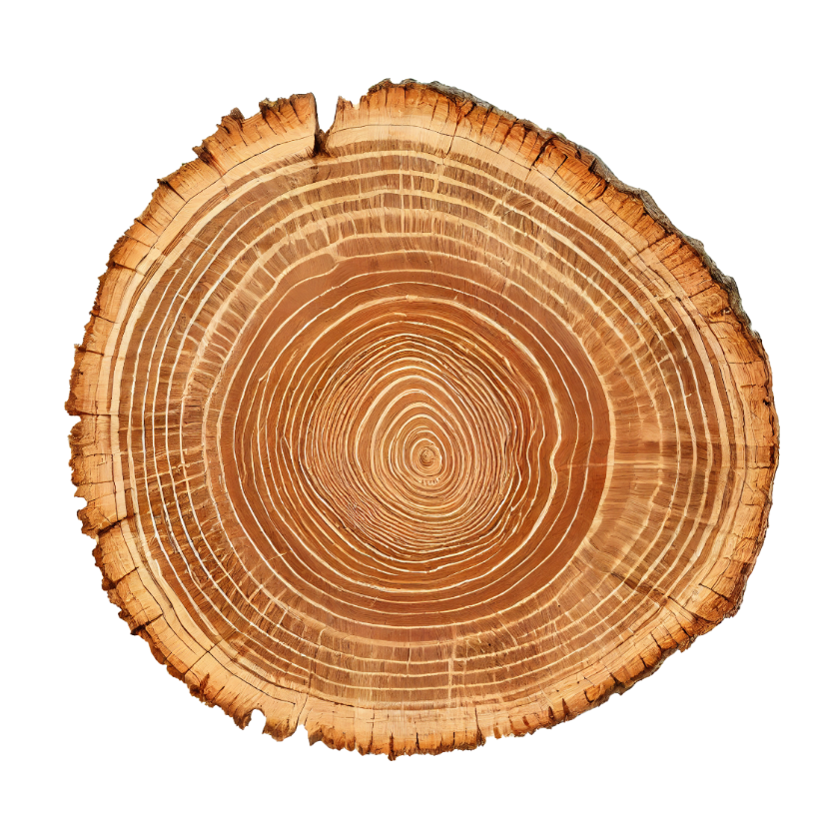
Starting from the centre count out years in their life and colour the rings
Notes:
Give everyone a slice of wood (ideally with a pre-drilled hole for hanging).
Say this tree slice is a cross section of a life – starting from the centre there is a ring for every year lived. The size and depth of colour of the ring tells us about that particular year and what happened as this tree grew.
We are going to use this to think about the life of the young person you have been talking about. Starting from the centre find the ring for the age at which you first met this young person and colour that ring. Then counting out colour any other rings for ages when you have been connected with them. If there have been significant years in their live choose an appropriate colour to mark that year.
Keep going until you reach the age they are today or were when you last knew them.

Slide 6
Do they know they are loved?
Notes:
Give everyone a heart sticker.
Research shows that teenagers today have half as many ‘in real life’ IRL social contacts as in the year 2000.
Read research sheet.
This research shows us that isolation and loneliness are growing issues for young people. They need to feel deeply cared for, and that someone believes in them. They need healthy relationships with adults beyond their immediate family. They need friendships with people not going through the same challenges of growing up as themselves – in fact people who have come through the other side (however long ago) and gone on to thrive in a huge variety of ways.
A key question therefore about any young person is do they know they are loved?
Invite everyone to add the heart sticker to their slice of wood and think about how this young person might know they are loved.

Slide 7
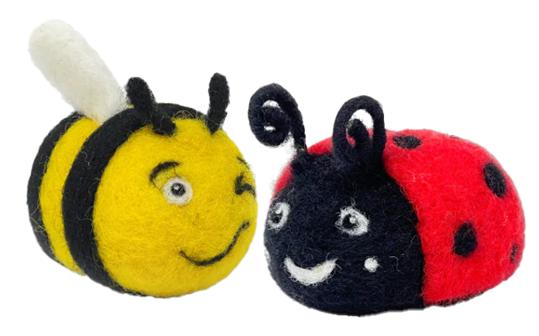
Who are the protectors and pollinators in their life?
Notes:
Give everyone a tiny sticky ladybird and bee.
Ask if anyone knows why ladybirds are called ladybirds? It is after ‘Our Lady’ Mary, Jesus’ mother. Ladybirds were seen by farmers as the answer to their prayers to protect their crops from pests.
Ladybirds are veracious pest eaters! They are fierce protectors – they bite! They can fly up to 150km!!
In what ways might the young people we are all thinking about need protecting? How could you or your faith community offer some protection or act as defenders and allies for these young people?
Invite people to add the ladybird to their slice of wood.
Bees symbols of God’s promises to us – a land flowing with milk and honey requires bees! Not just to make the honey (the product of a community working together to create nourishment for all) but also as super-pollinators. A forager bee may visit 2,000 flowers a day to collect nectar and pollen. One out of every three mouthfuls of our food depends on pollinators who help turn flowers into fruit and seed.
In what ways might the young people we are all thinking about need pollinators? How could you or your faith community offer some cross-pollination in their lives? How might you act as pollinators to help them develop ‘fruit’ and ‘seed’ in their lives?
Invite people to add the bee to their slice of wood.

Slide 8
How might they shine?
Notes:
Give everyone a gold or silver star sticker.
Think about this young person – their gifts and talents, their strengths and passions.
How might they need help to be able to shine? Are there any opportunities within the life of your faith community where they could contribute and grow?
Could you support and encourage them in some area of their lives?
How might you help them ‘shine like stars in the world’ (Phil 2:15 NRSV)?
Invite people to add the star to their slice of wood.

Slide 9
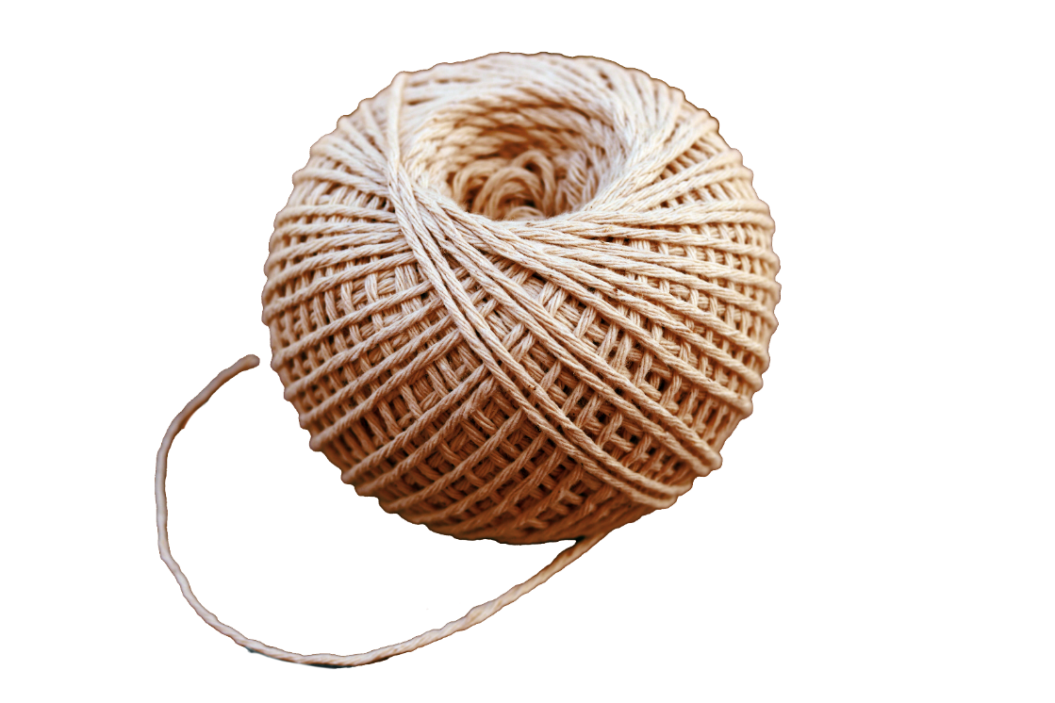
How can you support them?
Notes:
Invite people to turn to their neighbours and share any ways they could support these young people – in person, from a distance, through their families, in other ways.
Invite people to tie the string through their slice of wood and think about where they can hang this at home or in their place of worship / meeting as a reminder – perhaps they could hang it from a kitchen cupboard handle, a coat hook, a towel rail – or from a branch etc.

Slide 10
Changing the metaphor
Notes:
Parker J Palmer – an American Quaker writer, in ‘On the Brink of Everything: Grace, Gravity and Getting Old’ says:
“Let’s stop talking about ‘passing on the baton’ to the young as we elders finish running our laps. Since most of us are more skilled at sitting than running. Let’s change the metaphor and invite young adults to join the orchestra. As we sit together, we can help them learn to play their instruments – while they help us learn the music of the emerging world, which they can hear more clearly than we do. Together we can compose something lovelier and more alive than the current cacophony, something in which dissonance has a place but does not dominate.” (page 33)
Problems with passing the baton – it assumes young people are passively waiting for it to be passed, it might get dropped – so we hold onto it for too long. Also, once we have passed it on our race is over – we are now left on the side lines, defunct and no one want to be defunct.
Joining the orchestra – every new instrument changes the sound – every new person changes our community. Everyone is learning, and age does not determine the levels. We still have those gifted to lead different sections, and our success in playing together depends on our ability to listen deeply to one another.
How might changing the metaphor help your faith community to engage with young people?

Slide 11
A blessing for young people
Let no one despise your youth, but set the believers an example in love, in faith, in how to live. Fan into flames the gift of God that is within you and be strong in the grace that is in Christ Jesus. (Based on 1 Tim 4:12, 2 Tim 1:6 & 2 Tim 2:1)
Notes:
Here is a prayer you might like to use together – holding the slices of wood you have decorated as you have thought about particular young people – say these words together to bless those young people and all young people:
Let no one despise your youth, but set the believers an example in love, in faith, in how to live. Fan into flames the gift of God that is within you and be strong in the grace that is in Christ Jesus. (Based on 1 Tim 4:12, 2 Tim 1:6 & 2 Tim 2:1)
If appropriate invite people to use the resource on the URC website ‘Pray like Paul’ which uses Paul’s letters to Timothy in the New Testament as a framework for praying with and for young people for congregations and meetings asking: ‘where are the young people?’ You will find a range of short prayers written by young people here to use over a three-week period.
https://bit.ly/praylikepaul

