Slide 1
Using Exploring Eldership
Welcome to the guide to using the Exploring Eldership resource. We suggest that this section will be most useful if you download it to your computer and save it for reference later as you move through the programme.

Slide 2
Navigating this site - 1
There are a number of ways to navigate this resource. The following pages of this slideshow will demonstrate some of these ways. The highest level of navigation can be seen here in the ‘breadcrumb trail’ which you find at the top of each page, below the programme title. Clicking on 1 (on the image on the left of this slide) takes you to your own ‘home’ page, known as your dashboard, and from where you will find links to all the programmes you are enrolled in; 2 tells you which programme you are in at this moment. Clicking 3 takes you to the overview of the section that you are in right now. Clicking on 4 takes you to the start of the section, or subsection, you are in now.
In the example on the left you can see from the bread crumb trail that you are in the Exploring Eldership programme, in the section of that programme called God Calls Elders, and the sub-section ‘A brief history of Eldership part one.’ Clicking on 1, 2 or 3 takes you back to (or to the start of) each of those sections and 4 is where you are now.

Slide 3
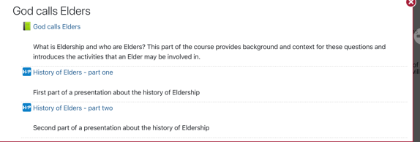
Navigating this site - 2
Once in the section you want (here the section called God Calls Elders) always start by clicking on the item with a green book icon next to it. Once you have worked through all the pages of the green book resource for each section you may find links to other resources for that section. You will see how to navigate forwards in the next few pages of this guide.

Slide 4
Navigating this site - 3
When you click on a green book icon and open a section you will see 3 columns on your screen. The left column gives you links to navigate all the different parts of the Learning Hub. These include links to the sections of this programme and one to your personal dashboard.
The middle column shows the content of the page you are on presently. The example here shows item ‘1. Introduction’ of the God Calls Elders section.
The right column is a list of all items in the part of the section that you are in right now (in this case you can see you are on page 1 of the 12 pages in this part of God Calls Elders). You can access any page in the section by clicking on the title of that page.
Important - this right column menu is the most important one for navigating the section or sub-section of Exploring Eldership that you are in presently.

Slide 5
Navigating this site - 4
You can also move through the pages of the section by clicking on the little blue arrows on the top and bottom right sides of any page – 1 on the image on the left. You can move back and forth through the pages of that section using these arrows. If you see a blue arrow that points upwards this means you are on the last page of that particular section. Clicking on that up arrow takes you back to the main menu.
The image on the left of this slide shows what you see as the middle column when clicking on the blue forward arrow on page one of God Calls Elders – 2 on the image.
The big blue box labels at the bottom are the way to navigate through the sections and subsections of the whole programme – 3 on the image.
Notice too that there are icons on this page – these indicate a particular kind of activity in the material. Here, for example, the top icon tells you there is a reflection exercise activity - 4, and the lower icon indicates that you will need to do some writing - 5.

Slide 6
Icons to guide you
The URC Learning Hub uses a variety of icons as visual alerts to allow you to see at a glance the kind of activity that is coming up.

Slide 7
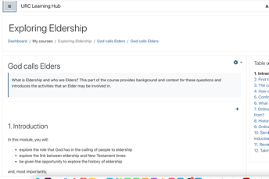
Closing the left-hand column
Other hints for navigating this programme involve closing down the left-hand column temporarily and scrolling.
To close the left column, click on the three horizontal lines in the top left-hand side of the screen – 1 on the image on the left of this slide, and the middle column will expand – 2 on the image.
When you need to get the hidden navigation back just click on the three lines again. The left column will reappear and allow you to move back to your Dashboard, and beyond the course you are currently in.

Slide 8
Scrolling
Once you have found the page in the programme that you need you may also need to scroll down the screen a little in order to see the whole page. This should only result in you temporarily losing sight of the heading on that page. You will note that the little blue arrows appear at the bottom of the page as well as at the top. So, when you have finished on the current page you should not need to scroll back up in order to move to the next page.

Slide 9
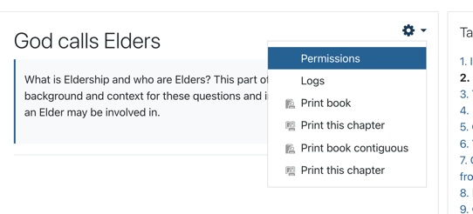
Printing
You won’t normally need to print anything out on this programme but if you do want to then there will usually be a printable version of that item available in the area called URC publications, transcriptions and other printable documents in the Introduction section.
From a green book section you can also choose to print a page of content. Towards the top right-hand corner of pages in ‘green book’ resources, you will see a gearwheel icon – click on that to see the options. To print just the page that you’re on click on “print this chapter”; to print all the pages in the section press “print contiguous”.

Slide 10
Using the History of Elders presentation
In the God Calls Elders section you will find a presentation in two parts – click on ‘History of Elders – part one’ to start viewing this presentation. Within the presentation use the little black arrows below the images to move forward. Use the purple question marks to read the text that goes with the image. You can also download, or print, the full text of the complete presentation by checking out the folder called Transcriptions and other printable documents in the Introduction section of Exploring Eldership where there is a transcript of the text that you can read, download or print.

Slide 11
Using the video and audio resources
This icon indicates that there is a video to watch or an audio file to listen to. Click on the arrow on the file to play the recording.
You should also find a hyperlink next to (or below) the file which will take you to a transcript of the video/audio which you can view online or download.

Slide 12
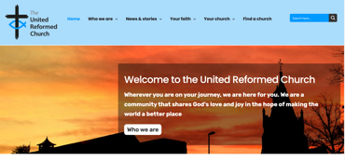
Finding out more about things in the programme
Each section has a page dedicated to further resources so that you can explore topics further if you wish.
There is also a section at the end of the Exploring Eldership programme that is dedicated to URC publications and resources.
Although, your first port of call for anything about the URC should be the URC website:
https://urc.org.uk/

Slide 13
Using this programme
This programme is designed to be used by you on your own as an individual, in your own time and as much or as little as you wish. However, you can also study it as a group – with other Elders from your church perhaps. Many of the exercises can be shared and – where suitable – ideas for group discussion are given in the programme. Any way that you want to use these materials is fine with those of us who have put them together! Enjoy!

Slide 14
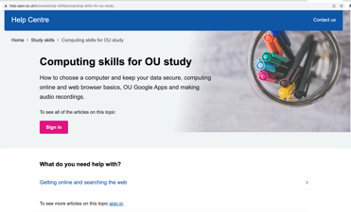
More kinds of help with using this programme
https://help.open.ac.uk/browse/study-skills/computing-skills-for-ou-study
Help with working online – can be found in different places. There may even be a local option for developing your skills – your local Citizens Advice Bureau or Job Centre may be able to help you find in-person training options.
If you are happy to learn computing skills for study online then try the Open University study skills resources – signing up for these is totally free, you don’t need to be an OU student to use them. And, their study skills pages cover everything from working online to making notes, writing and many other useful topics.
https://www.gov.uk/career-skills-and-training

Slide 15
Links to other Learning Hub resources
For links to other programmes in the Learning Hub – see the ‘Take a Look…’ section. This where you will find instructions for how to join other URC programmes like Stepwise and the Church Leadership Programme.
You can access ‘Take a Look…’ from your dashboard.

